Slide 1
Fundamentals of the Housing Choice Voucher (HCV) Program a/k/a Section 8 or Voucher
Greater Boston Association of Realtors
March 25, 2021
Robert P. Cwieka
HUD, Boston

Slide 2
HUD’s Office of Public & Indian Housing
The Office of Public and Indian Housing (PIH) ensures safe, decent, and affordable housing, creates opportunities for residents' self-sufficiency and economic independence, and assures the fiscal integrity of all program participants.
PIH Office Administers the following programs:
Public Housing
Housing Choice Voucher

Slide 3
PIH Programs Overview
Housing Choice Vouchers
Government program assisting very low-income families, the elderly, and the disabled to afford decent, safe, and sanitary housing in the private market. The family or individual participants can find their own housing, including single family homes, townhouses and apartments.
Housing choice vouchers are administered locally by public housing agencies (PHAs). The PHAs contract with HUD to administer the voucher program.
A housing subsidy is paid to the landlord directly by the PHA on behalf of the recipient(s). The family pays the difference between the actual rent charged by the landlord and the amount subsidized by the program. Under certain circumstances, if authorized by the PHA, a family may use its voucher to purchase a modest home.

Slide 4
Housing Choice Vouchers Facts
Eligibility
Determined by the PHA based on the total annual gross income and family size. In general, the family's income may not exceed 50% of the median income for the metropolitan area in which the family chooses to live. By law, a PHA must provide 75 percent of its voucher to applicants whose incomes do not exceed 30 percent of the area median income.
If eligible, a family applies and will be placed on a waiting list, unless it is able to assist you immediately. Once your name is reached on the waiting list, the PHA will contact family and issue a housing choice voucher.

Slide 5
Housing Choice Vouchers Facts
Finding Housing
Once a Section 8 voucher is issued the PHA gives the assisted family at least 60 days to obtain housing. Under certain circumstances the PHA may grant extensions, usually in 30 increments.
Portability
Process through which a family can transfer (port) their rental subsidy to move to a location outside the jurisdiction of the PHA that first issued their voucher.
New families may not be able to port immediately; they may have to live in the jurisdiction of the initial PHA for a year before they can port.
  Initial PHAs: PHA that first issued the Section 8 voucher.
  Receiving PHAs: PHA that administers Section 8 voucher after recipient moves.

Slide 6
Housing Choice Voucher Facts
Rent Determination (Family)
Rent or Total Tenant Payment (TTP) is based on a family's anticipated gross annual income less deductions, if any. The formula used in determining the TTP is the highest of the following: 30 percent of the monthly adjusted income; 10 percent of monthly income; welfare rent, if applicable; or a $25 minimum rent or higher amount (up to $50) set by an HA.
A housing voucher holder is advised of the unit size for which it is eligible based on family size and composition.

Slide 7
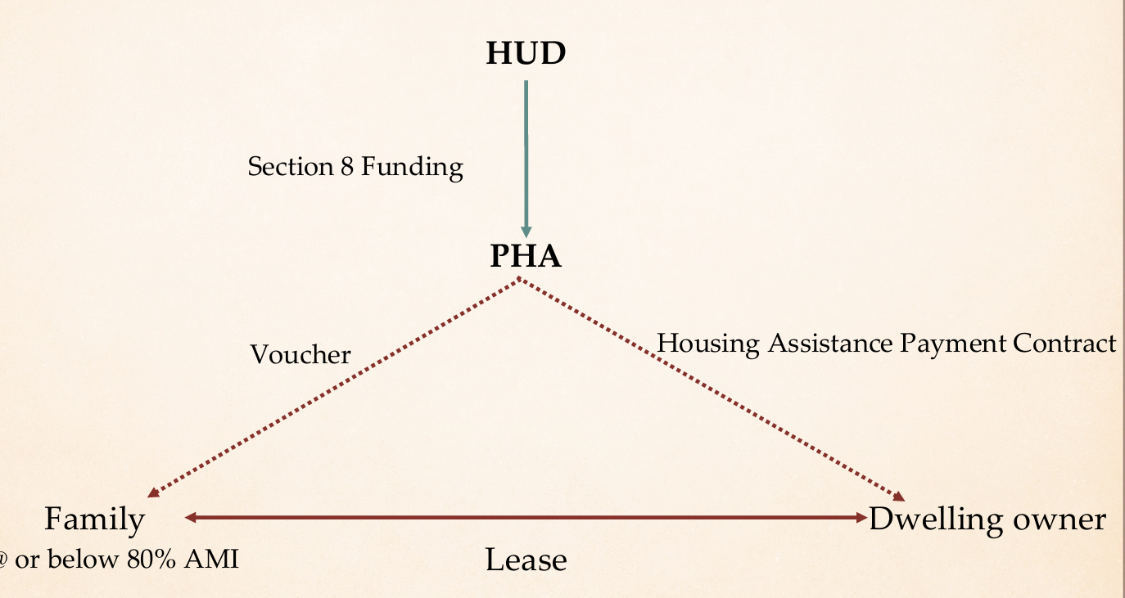
Relationships

Slide 8
Roles in the HCV program
The tenant, the landlord, the housing agency
Once a PHA approves an eligible family’s housing unit, the family and the landlord sign a lease and, at the same time, the landlord and the PHA sign a housing assistance payments contract that runs for the same term as the lease. This means that everyone -- tenant, landlord and PHA -- has obligations and responsibilities under the voucher program.

Slide 9
Roles in the HCV program
Tenant (participant or family)
Family selects a housing unit,
Family signs a lease with the landlord for at least one year.
The tenant may be required to pay a security deposit to the landlord.
Family is expected to comply with the lease and the program requirements, pay its share of rent on time, maintain the unit in good condition and notify the PHA of any changes in income or family composition.

Slide 10
Roles in the HCV program
Landlord
Provide decent, safe, and sanitary housing to a tenant at a reasonable rent.
Maintain dwelling unit up to at least HUD’s Housing Quality Standards as long as the owner receives housing assistance payments.
Provide the services agreed to as part of the lease signed with the tenant and the contract signed with the PHA.

Slide 11
Roles in the HCV program
Housing Authority
Administrator of the voucher program locally.
PHA provides a family with the housing assistance that enables the family to seek out suitable housing
PHA enters into a contract with the landlord to provide housing assistance payments on behalf of the family.
Enforce owner's obligations under the HAP. PHA has the right to terminate assistance payments.

Slide 12
Roles in the HCV program
Housing Authority
The PHA must reexamine the family's income and composition at least annually
Must inspect each unit at least annually to ensure that it meets minimum housing quality standards.

Slide 13
Roles in the HCV program
HUD
Cover the cost of the program through appropriations.
HUD provides funds to allow PHAs to make housing assistance payments on behalf of the families.
HUD also pays the PHA a fee for the costs of administering the program.
HUD monitors PHA administration of the program to ensure program intergrity.

Slide 14
What is the value of a HCV?
The value is determined by the PHA and is based on the existing Fair Market Rents (FMRs).
FMRs published annually by HUD (link on resource page)
The PHA sets value at between 90 – 110% of the FMR for the appropriate unit or voucher size and is called the Payment Standard.
Payment Standard is updated annually

Slide 15
Value of HCV - example
Payment standard of a two-bedroom apartment is $2,000.00 and your household monthly adjusted income is $1,000, a PHA will pay a maximum of $1,700.
$2,000 Payment Standard
- $300 (30% of $1,000; amount family will pay)
= $1,700 (maximum amount BHA will pay toward your rent)

Slide 16
Links to HUD Resources
HOUSING CHOICE VOUCHERS FACT SHEET
  https://www.hud.gov/program_offices/public_indian_housing/programs/hcv/about/fact_sheet
  https://www.hud.gov/sites/dfiles/PIH/documents/HCV_Fact_Sheet_Landlords.pdf
HUD'S PUBLIC HOUSING PROGRAM
  HTTPS://WWW.HUD.GOV/TOPICS/RENTAL_ASSISTANCE/PHPROG
INCOME LIMITS
  HTTPS://WWW.HUDUSER.GOV/PORTAL/DATASETS/IL.HTML
FAIR MARKET RENTS
  https://www.huduser.gov/portal/datasets/fmr.html

